Slide 1

Misbehavior and Misinformation on the Web and Social Media
Detection, Spreading, and Mitigation Strategies

Slide 2
Misinformation vs. Disinformation
Misinformation
Incorrect information that is accidentally spread without the intention to mislead.
It doesn’t care about the intent.
Misinformation
Disinformation
Incorrect information that is spread without the intention to
mislead or deceive.
Disinformation is knowingly spreading misinformation.
Disinformation
Spread of Misinformation
Mishear
Misremember
Unknowingly sharing of misinformations.
Cartoon Source : https://www.davegranlund.com/cartoons/2016/12/08/fake-news-and-internet/
Notes:
# misinformation and disinformation. These two words, so often used interchangeably
# What is the critical distinction between these two confusable words: answer is intent.
# Misinformation doesn’t care about intent, and so is simply a term for any kind of wrong or false information.
# Disinformation : “deliberately misleading or biased information; manipulated narrative or facts; propaganda.”
When distinguishing between misinformation and disinformation, keep one very important word in mind: intent. Although both words refer to types of wrong or false information, only disinformation is wrong on purpose.
## Spread of Misinformation
# Mishear or Misremember any detail
# Spreading around information that is wrong but you don’t know it is wrong
then you are, well, technically, spreading misinformation.

Slide 3
Types of Misinformation (content based)
Satire
Social commentary or humor which has potential to fool but no intention to harm
False connection
When Captions or visuals does not support the content, like eye-catching or exciting headline
Misleading Content
Misleading presentation of information to provoke an issue or frame an individual: Propaganda, Hoax
False context
Genuine Content is shared with false Contextual information : Conspiracy Theory
Imposter Content
Genuine sources are impersonated, like creation of Sponsored Content looking like Editorial
Manipulated Content
Genuine information or imagery is manipulated to deceive : Rumor
Fabricated Content
News of 100% false content entirely designed to deceive and cause harm : Fake News, Fake Reviews
Source : https://medium.com/@CharlieBeckett/why-fake-news-can-be-great-for-journalism-20ba2f309927
Notes:
# Propaganda : biased or misleading info used to promote a political cause or point of view
# Hoax: False information pretending to be true and sometimes intended as a joke
# Conspiracy Theory: rejects the standard explanation for an event and instead credits a covert group or organization with carrying out a secret plot
# Rumor : pieces of information whose veracity is unverifiable and spreads very easily.
# Fake News:False or misleading information that is spread deliberately to deceive
# Fake Reviews: Dishonest Opinion in a context where there is no absolute ground truth

Slide 4
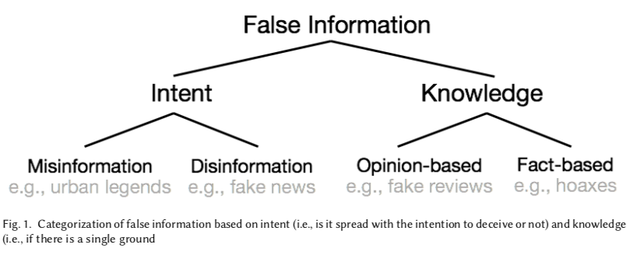
Fake News
Types of False Information:
Intent based:
1. Misinformation (urban legends)
2. Disinformation (Fake News)
Knowledge based:
1. Opinion based( fake reviews)
2. Fact-based (hoaxes)
Source : Srijan Kumar, Neil Shah: False Information on Web and Social Media: A Survey. CoRR abs/1804.08559
https://arxiv.org/pdf/1804.08559.pdf
Notes:
Based on : False Information on Web and Social Media: A Survey by Srijan Kumar, Neil Shah
# Categorization based on intent
# Categorization based on Knowledge

Slide 5
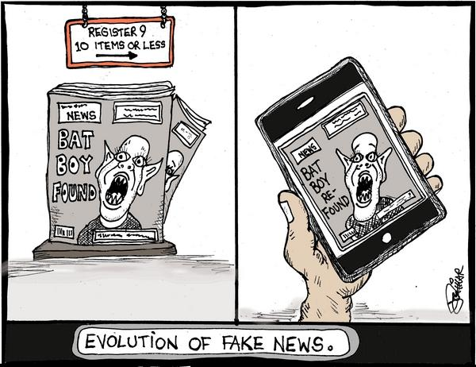
Fake News
Fake news is a misleading information where the content is 100% false and spreading of this news is done deliberately where the intention is entirely to cause harm or to deceive.
Three Characteristics:
Whether the information is news
Authenticity
Intention
Cartoon Source : Milford Daily News : https://www.milforddailynews.com/opinion/20170202/liccar-cartoon-fake-news?template=ampart
Notes:
There has been no universal definition for fake news

Slide 6
Misinformation is Dangerous
How a misinformation is dangerous completely depends on
Context
How important the context is :
Rumor about an actor (does not have that much vast impact)
Effectiveness of a medicine or treatment (serious effects)
Source or Spread
How widely distributed :
Misperceptions of a Scientific Findings
(difficult to understand, not every people’s interest, smaller spread)
False claim from a Supreme Court justice on an act (larger spread with serious effect)
Real World Example
Stock Market Crash, Source and Spread of the COVID19
Notes:
Context :Misinformation about whether a celebrity is dead or not is harmless,
but misinformation about the effectiveness of a medicine or treatment could have more serious effects.
Source: how widely it’s distributed.
most popular false information pieces attract more attention than real information,
and false information spreads widely and quickly mostly across the web and reaches a large population.
Real world Example : Stock market crash,
misinformation on Covid -19 : Indeed, misinformation about the COVID-19 pandemic is a serious threat to
both public health and international relations Like where the virus originated from. Or false info of treatment
For example, false conspiracy theories about 5G masts causing or exacerbating COVID-19 symptoms have
led to people setting mobile phone masts ablaze, endangering lives and property
https://www.businessinsider.com/coronavirus-conspiracy-5g-masts-fire-2020-4

Slide 7
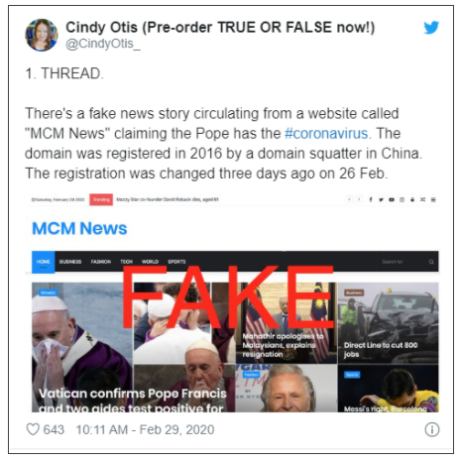
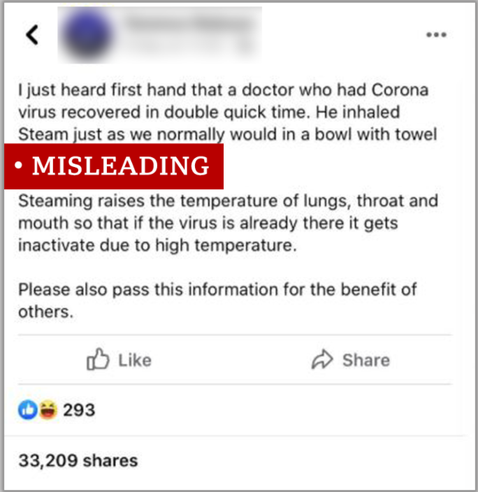
Why is it important to understand Misinformation?
Consumption by wider audience.
Image credits: https://www.bbc.com/news/52124740

Slide 8
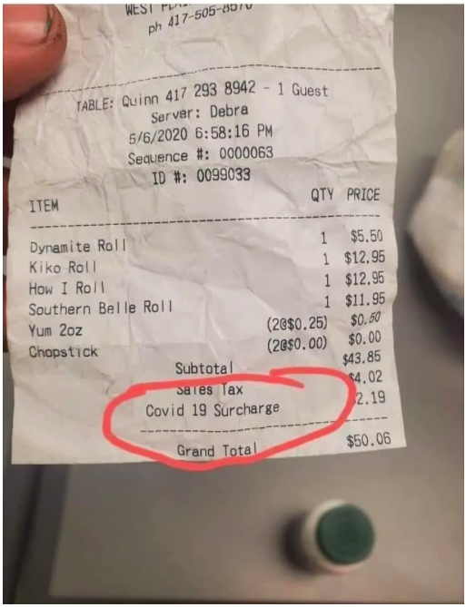
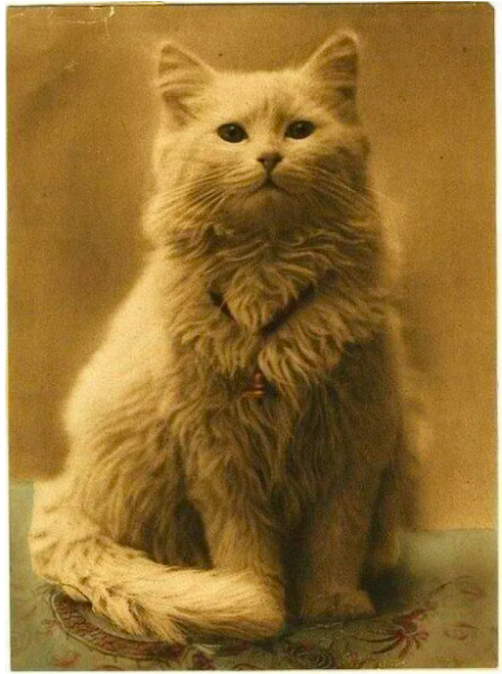
Example of News : What Do You Think ?
“ Does This
Restaurant
Receipt
Show
a COVID-19
Surcharge? ”
“ Is This
the World’s Oldest
Cat Photo? ”
https://www.snopes.com/fact-check/covid-surcharge-restaurant/
https://www.snopes.com/fact-check/worlds-oldest-cat-photo/
Notes:
Title? Ask audience

Slide 9
Explanation of Truthful vs. Fake News Examples
“Does This Restaurant Receipt Show a COVID-19 Surcharge?”
Characteristics of this news:
It can be verified in fact checking websites.
The news has been published in several authentic source
Report from Springfield, Missouri, television station KYTV
Receipt origination can be verified
Originated from the Kiko Japanese Steakhouse & Sushi Lounge
in West Plains, Missouri
The Restaurant also admit it in a Facebook post:
“Recently our employees been getting harassed due to some peoples miss-use the actual
picture of our receipt from our actual customer that being going around on social media, even
trending on twitter due to the surcharge title!”
So, this news is a TRUE one.

Slide 10
Explanation of Truthful vs. Fake News Examples
“ Is This the World’s Oldest Cat Photo? ”
Characteristics of this news:
Undetermined News Source.
Misinformation:
Claims that it was taken in the 1880s,
but first photo of cat date back to 1840s.
Discrepancy:
Photograph did not use the same methods used in the 1840s.

Slide 11
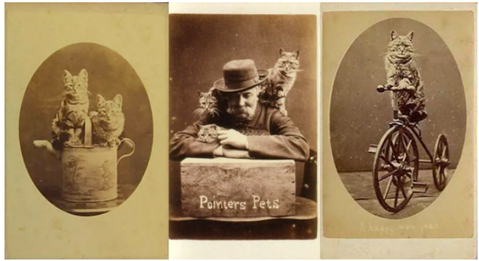
Explanation of Truthful vs. Fake News Examples
“ Is This the World’s Oldest Cat Photo? ”
Some Fact Checking:
Photographer Pointer did “Brighton Cats” photography in the 1870s.
Review published in the 1879 issue of The Art Journal of London.
The earliest (cat on water can) was taken nearly 1870.
Photography historian David Sinkin mentioned about other cat-photographers at that time of 1860s
Few photographs from the Brighton Cats series, the earliest of which (cat on water can) was taken nearly 1870
Notes:
A British Photographer named Pointer was famous for photography
of “Brighton Cats” in the 1870s.
A review of Pointer’s of animal photographs published
in the 1879 issue of The Art Journal of London.
The earliest of which (cat on water can) was taken nearly 1870.
Photography historian David Sinkin mentioned that there were
some other photographers at that time of 1860s, who also did cat-photography.

Slide 12
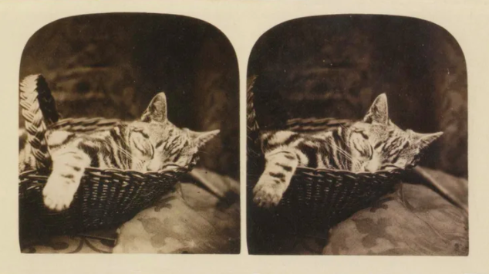
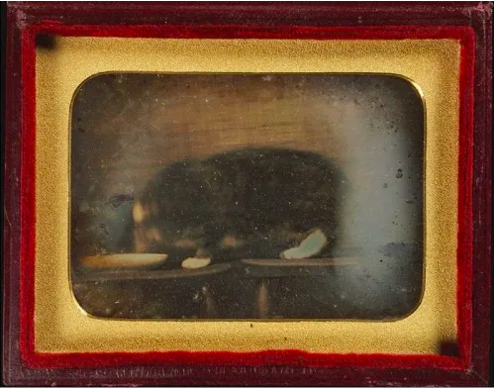
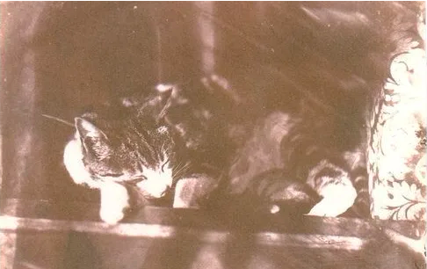
Explanation of Truthful vs. Fake News Examples
“ Is This the World’s Oldest Cat Photo?”
Photographer :
Rev. Calvert Richard Jones
1860
1845
1854
Photographer :
William Henry Mason Jr.
This is a FAKE news

Slide 13
Characteristics of Fake vs. Truthful News
Characteristics of Fake News:
Textual characteristics
Incoherent Headline and Body content
Attractive and emphasised headline
Less informative body content
User (creator) characteristics
Recently registered accounts
Less editing experience
Network characteristics
Fewer references
Lower clustering coefficient
User-user network is strongly connected
Propagation characteristics
Spreads by small fraction of users
Spreads deeper
Spreads quickly at the beginning
Spreads across platforms
Debunking characteristics
Time delay between the spread
and its debunking
Source: Srijan Kumar, Neil Shah: False Information on Web and Social Media: A Survey. CoRR abs/1804.08559 (2018).
Notes:
Textual characteristics
# Inconsistency in between title of the story and body part.
# It shows the main claim to the headline. The titles are longer but use fewer stopwords with more proper nouns and verb phrases,
It shows that the creators tend to put as much information in the title as possible.
The words used in the title are smaller and capitalized more often, to generate emphasis.
# Body content: fake news articles are short, repetitive, and less informative (fewer nouns and analytical words). They contain fewer technical words, more smaller words, and are generally easier to read. The bodies are less wordy and contain fewer nouns, technical and analytical words
## These are the critertias of satire news. So, fake news articles are more similar to satirical ones than to real news
User (creator) characteristics
# Several studies have shown that the characteristics of creators of false information are different from those of true information creators.
# have typically more recently registered accounts
# Studies shows that sometimes rumors are spread by automated accounts in short-bursts of time.
# Also the have less editing experience
# they lack the skills to create well-written articles, which leads to others believing that the article is a hoax.
Network characteristics
# Studies on measuring the connectedness of the different hoax articles from Wikipedia
# the clustering coefficient, which is a measurement of the connectedness., was computed, was computed for of the local hyperlink network of the article
# obviously, high connectedness indicates interrelated and coherent references
# significantly lower clustering coefficient which means hoax information has fewer references
# Strongly connected user-user network and studies in Twitter shows they appear as groups in Twitter’s follower-followee network
Propagation characteristics
# small fraction of users : like that the top 30 users contributed towards 90% of the retweets of fake info
# analysis suggested that fake news spread was mostly dominated by a handful of very active users
# spreads deeper : When false information spreads in social platforms, it spreads deeper compared to real news.
it’s more likely to be reshared at greater depth and thus reach more people
Simulation conduction shows that even a rumor started by a random node on average reaches 45.6 million of the total of 51.2 million members within only eight rounds of communication.
# spreads quickly, especially during its early stage even before it is debunked and veracity is checked
# the virality of popular false information during its initial phase is high
# false information pieces are more likely to spread across platforms (18% appear on multiple platforms) compared to true information (11%).
Debunking characteristics
Once false information spreads, attempts are made to debunk it and limit its spread.
# research has shown that there is a significant time delay between the spread and its debunking
# but it is in effective, it leads to a 4.4 times increase in deletion probability of false information than when it is not,
and the probability is even higher if the link is made shortly after the post is created.

Slide 14
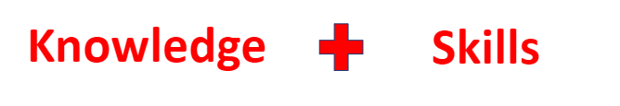
The 5 C’s of News Literacy
Context
Creation
Content
Circulation
Consumption
We define news literacy as knowledge of the personal and social processes by which news is produced, distributed, and consumed, and skills that allow users some control over these processes.
What is News Literacy?

Slide 15
Context
The Social, Legal and Economic environment in which the news is produced.
Various influences to shape content in media,
Advertising
Technology
Government
Public relations
Audiences
Utilize the influences to monetize the efforts of content producers.
Users should have the knowledge on the political and economic contexts of media.

Slide 16
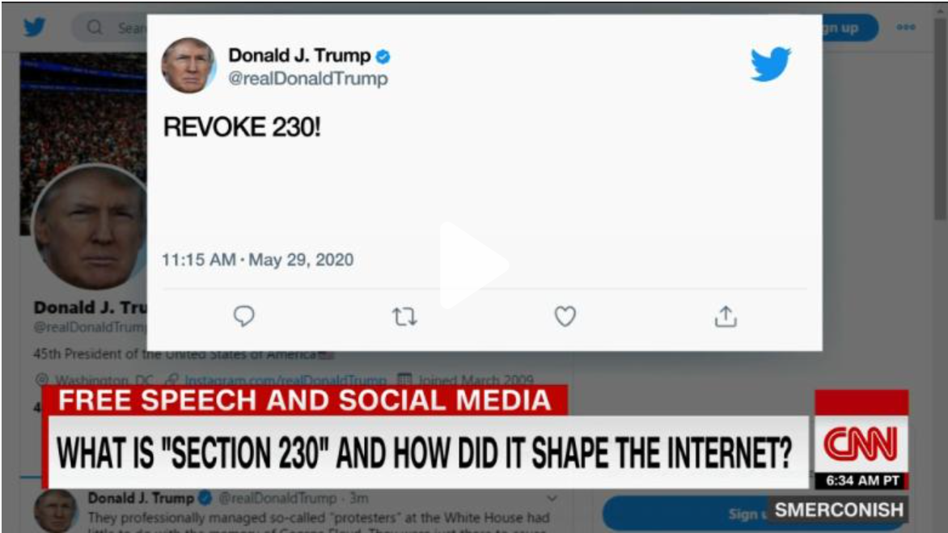
Context
Section 230 - Communication Decency Act
No provider or user of an interactive computer service shall be treated as the publisher or speaker of any information provided by another information content provider.
Immunity in social media.
Increases the spread of misinformation.
Organization will be least bothered about the content posted in their websites.
Twitter has introduced labels for fact-checking.

Slide 17

Creation
News creation is the process of conceiving, reporting and creating news by journalists and other related actors
Who creates fake news
Teenagers from macedonia created fake news in the 2016 US election!
Fake news creators are more like hackers
Fake news creator can be extremist
Political parties
Notes:
https://www.vindy.com/life/lifestyles/2020/09/fake-news-creators-are-a-lot-like-hackers/
https://www.npr.org/sections/alltechconsidered/2016/11/23/503146770/npr-finds-the-head-of-a-covert-fake-news-operation-in-the-suburbs
https://www.buzzfeednews.com/article/craigsilverman/how-macedonia-became-a-global-hub-for-pro-trump-misinfo

Slide 18

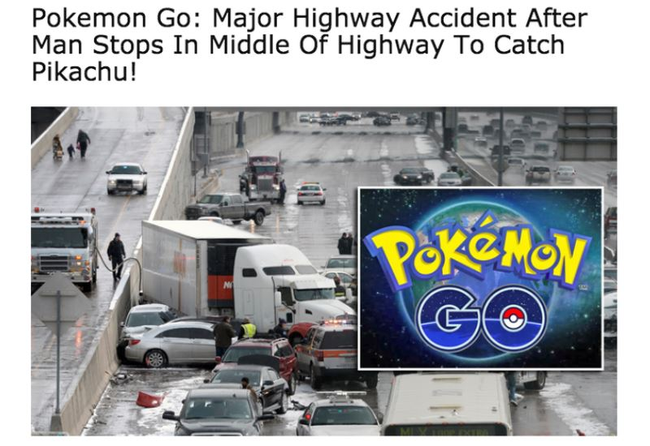
Creation
Why fake news is created
Fake news pays! (More clicks > more advertisement > more pay )
Political reasons
Get revenge / teach someone a lesson
Out of hatred, spite or jealousy
To promote an ideology
To harm a business competitor
To promote products
Source: https://30secondes.org/en/module/why-is-fake-news-invented/
Notes:
Pokemon go: The image was taken from a real car crash, but someone put the pokemon go image on top of it to argue this crash happened when someone stopped in the middle of the highway to catch pikachu (a character of pokemon)

Slide 19
Creation
Journalism skills
Audience can employ the skills of journalists, while processing information and constructing messages.
Verification - process of confirming and checking facts.
Multiple credibility sources - eyewitnesses, officials and experts.
Avoidance of bias - presenting facts and contents in a dispassionate manner.
Documentation - reports, studies, data, videos, photos and audio recordings.
Fairness - treating everyone with respect and provide chance to share their points.
Balance - presenting both side of the story, events or controversies.
Context - presenting information in a clear, fair and accurate way.
Consumers can utilize these skills while differentiating between real and fake news!
Notes:
http://newslit.org/wp-content/uploads/2020/09/PracticingQualityJournalism-2020.pdf

Slide 20
Content
Content is the qualitative characteristics of a news story or piece that distinguishes it from the other types of media content
Characteristics of real vs fake news
Fake news tend to be shorter in terms of content.
It requires a lower educational level to read.
Fake titles are longer, contain shorter words, more all capitalized words, fewer stop words, fewer nouns, more proper nouns.
Titles of real and fake news differs strongly.
Factually inaccurate.
Fake news spread significantly faster, farther and more deeper than the real news.
Fake news are mean to obscure or distort with emotions, preying on prejudice or bias.
Notes:
optimized for sharing: Fake news are easy to share

Slide 21
Content
Characteristics of real vs fake news
Image features i.e. expressions and emotions of depicted people are good features for differentiating real and fake news.
Fake news can contain fake images to provoke emotional response of the readers.
News source moderate to strongly biased are more likely to publish misleading news. (e.g.,hyper-partisan news sources are more likely to spread false news).
Source: https://link.springer.com/chapter/10.1007/978-3-030-61841-4_18
Notes:
Hyper partisan: extremely biased in favor of a political party.

Slide 22
Circulation
News Circulation is the process of distributing a news among the potential users.
False information Circulation Behavior
attracts more attention than real one,
spreads widely and quickly (mostly across the web) and
reaches a large population
Circulated From
Organizations (e.g., news outlets, social media companies, advertisers),
Individuals (e.g., journalists, coders, audiences)
Machines / Algorithms (e.g., search and social algorithms)
Notes:
news circulation is a process that is influenced by a variety of actors.
In the role of news circulation Organizations and Individuals are kind of traditional or conventional
--- More or less we know about them how they can spread news : publish newspaper, posters, or sharing a news with friend etc.
But “Machines or Algorithms” ‘s role is relatively newer than the other sources.
--- So, here we will focus on it.

Slide 23
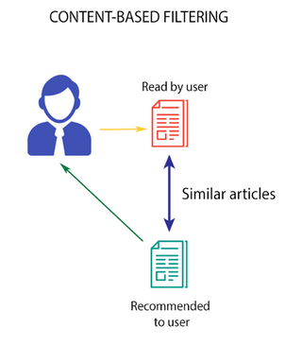
Circulation
Machine / Algorithms in News Circulation
Algorithms can
display news based on learning based on user’s search, clicks, likes or readings and similar users’ profiles
sort, filter, find, and rank content based on a user’s predetermined set of preferences
Excessive customization and personalization settings may causes Filter Bubbles
which trapped the user in a bubble of similar articles
Picture Source : https://www.analyticsvidhya.com/blog/2018/06/comprehensive-guide-recommendation-engine-python/screenshot-from-2018-06-21-10-57-38/
Notes:
Users are relying on algorithmic decision-making
A survey done by Newman and colleagues on (2018) found that only 29% of survey respondents knew that the news they see on
Facebook is determined by “computer analysis” (algorithm); most (40%) responded that they did
not know how these decisions were made which proves the lack of understanding about news
circulation on social media.
**users need to understand that they can influence the content they see,
** Customizing settings and feeds to expose oneself to diverse high-quality
news content would reflect that users understand circulation and are able to exercise

Slide 24
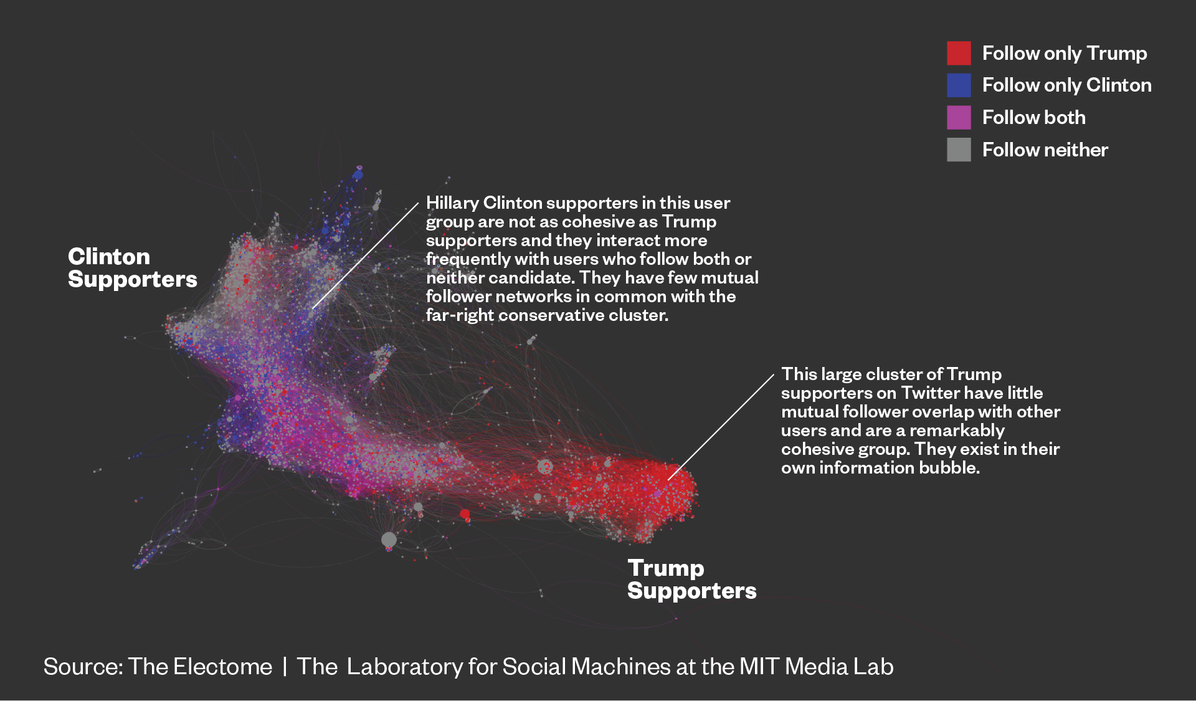
Consumption
Personal factors that contribute to news exposure attention, and evaluation and recognition of the effects of such consumptions.
It involves,
Selective exposure - that matches view.
Relying on digital and social media - to filter out other’s view.
Political alignment.
Stereotype and social cognition - on social judgement about race and crime.
Users’ psychological features influences his/her consumption of fake or real news.
How Clinton and Trump supporters are connected on twitter
Source: https://web.media.mit.edu/~msaveski/assets/publications/2018_social_mirror/paper.pdf

Slide 25
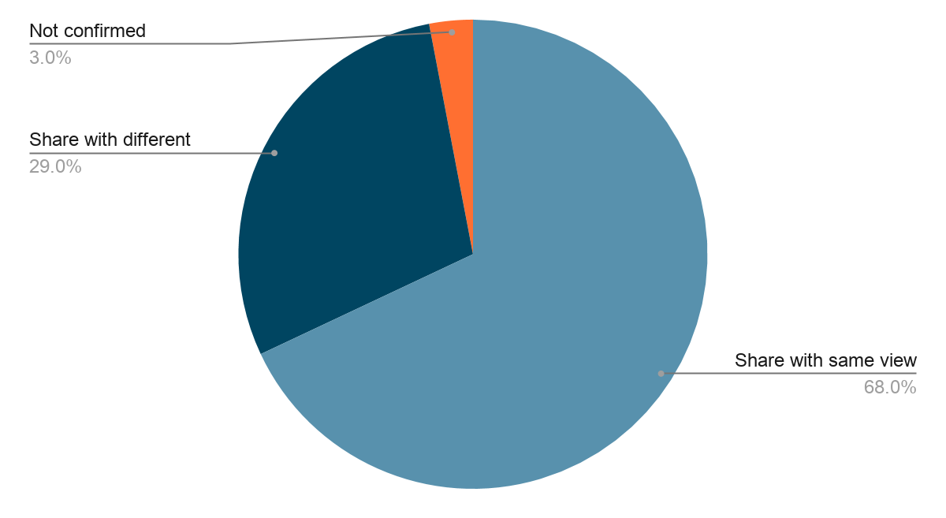
Consumption : Confirmation Bias
Favoring information that confirms previously existing beliefs or biases.
Impact
Influences how people find news
How people share information
Poor judgement
Wrong decision making
How people share news and information.
Source: https://newslit.org/tips-tools/dont-let-confirmation-bias-narrow-your-perspective/

Slide 26
Project
on
Detecting Fake News

Slide 27
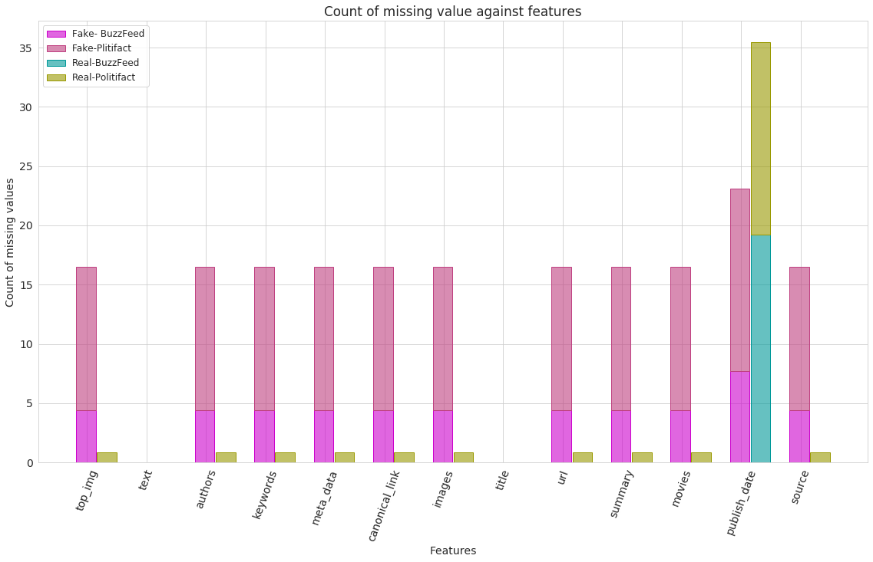
Data Description
Our dataset includes two datasets that contain both the news content and social context information. The fake news ground truth were collected from two platforms: BuzzFeed and PolitiFact.
 | Politifact | Buzzfeed
Number of news (Fake+Real) | 120+120 | 91+91
Number of nodes | 23K | 15K
User-news relationships | 32K | 22K

Slide 28
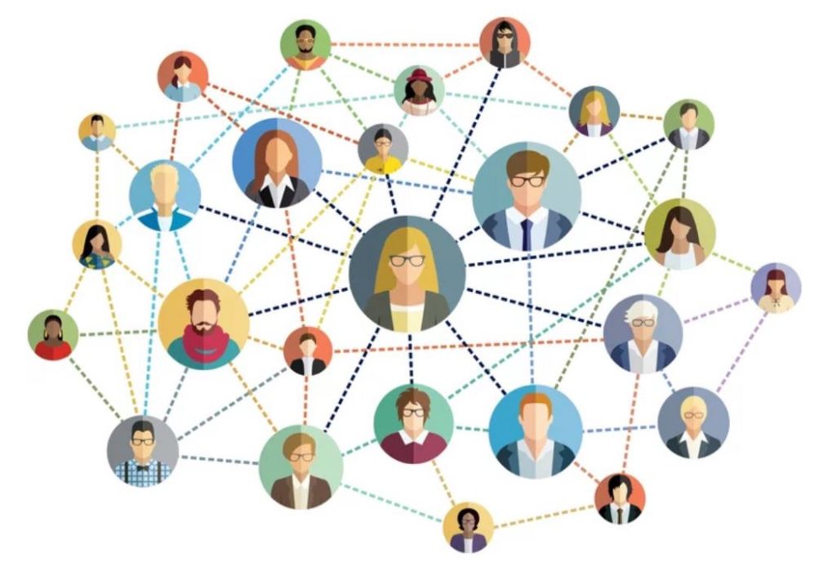
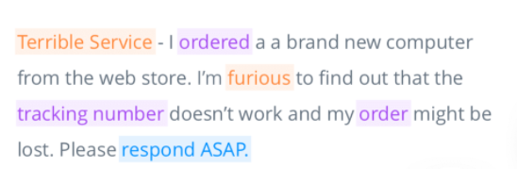
Feature Engineering
Features we considered:
News Content’s Textual Measures :
Word Counts
Punctuations Counts
Uppercases & Lowercases Counts
Video Counts
@ Mention Counts
Count of common/extreme words (eg., shares, Breaking, Do not)
Title Length
Sentiment Analyzer - Polarity
Number of Authors
Number of shares per news
Topic Modeling
Network Features:
Degree Centrality
Closeness centrality
Betweenness centrality
Eigenvector centrality
Do you feel this text negative or positive?
Source:https://monkeylearn.com/text-analysis/

Slide 29
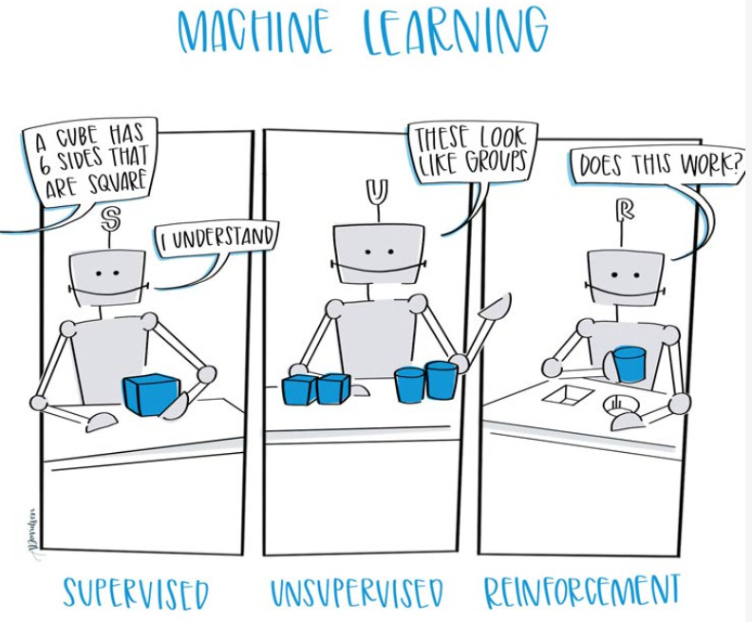
Classifiers
Performance measures of the Classifiers:
Classifiers | Accuracy
Gaussian Naive Bayes | 70.62
Support Vector Machine | 78.92
Logistic Regression | 79.63
XGBoost | 81.51
Random Forest | 83.64
Extra Trees | 85.77
Source: https://www.ceralytics.com/3-types-of-machine-learning/
Notes:
horne and adali

Slide 30
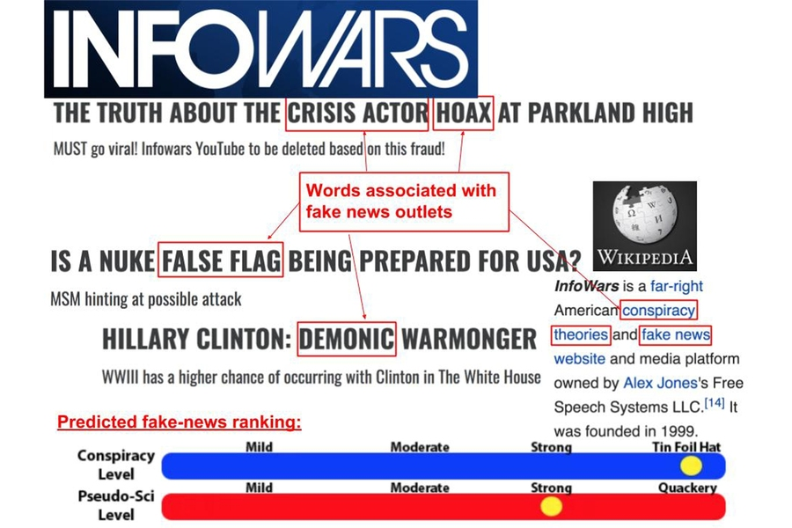
Tips on detecting fake news
Is the source is authentic?
Check the hyperlink included
Reverse image search
Identify the News Outlet and check the Web Domain
Do a visual assessment assess the overall design.
Turn to Fact Checkers
Assess Spelling, Grammar, and Punctuation
Are there multiple articles by other news outlets on this topic?
Identify the Author
Words mostly used in Fake News
Source: https://news.mit.edu/2018/mit-csail-machine-learning-system-detects-fake-news-from-source-1004
Notes:
Last slides: Ending presentation, by reminding students on the tips of detecting fake news.

Slide 31




How to spot Fake news?
Notes:
Last slide: Ending presentation, by reminding students on the tips of detecting fake news.

Slide 32
Thank You
Any Questions?
Notes:
Last 10 minutes to discuss.
Total:45 minutes
Presentation: 20-25 minutes

Slide 33
Presented By
Abishai Joy
Farhana Alam
Mostofa Najmus Sakib
Qudrat E Alahy Ratul

